Slide 1
Doppler
Doppler Effect
Vector Formulation
Doppler Simulation
Doppler Simulation via Delay Lines
Time-Varying Delay-Line Reads
Variable Delay Line in Software
Multiple Read Pointers
Multiple Write Pointers
Stereo Processing
System Block Diagram

Slide 2
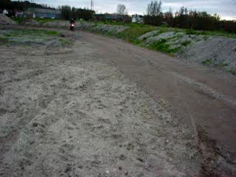
Doppler Movie

Slide 3
Stationary Sound Source
Sound waves produced at constant frequency f₀
Wavefronts propagate symmetrically away from source at constant speed c
speed of sound in the medium
Distance between wavefronts is wavelength
All observers hear same frequency
Equal to actual frequency of source

Slide 4
Source moving with v_{source}<c (Mach 0.7)
sound source radiating sound waves at a constant frequency
sound source moving to right with speed v_{s}=0.7c (Mach 0.7)
source moving→center of each new wavefront slightly displaced to right
wavefronts bunch up on right side (in front) of source
spread further apart on left side (behind) of source
observer in front of source hears higher frequency f ´ > f₀
observer behind source hears lower frequency f ´ < f₀

Slide 5
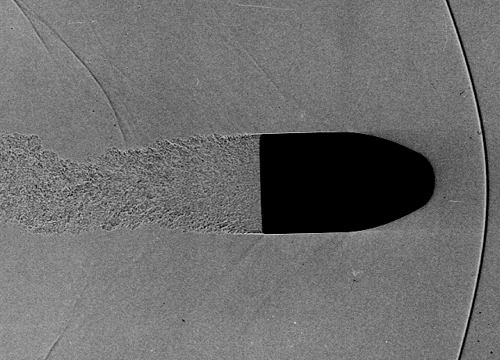
Source moving with v_{source}=c
source moving at speed of sound in medium (v_{s} =c, or Mach 1)
speed of sound in air at sea level ~ 340m/s or 750 mph
wavefronts in front of source now all bunched up at same point
observer in front of source will detect nothing until source arrives
pressure front will be quite intense (a shock wave), due to all wavefronts adding together
not perceived as pitch but as thump of sound as pressure wall passes by

Slide 6
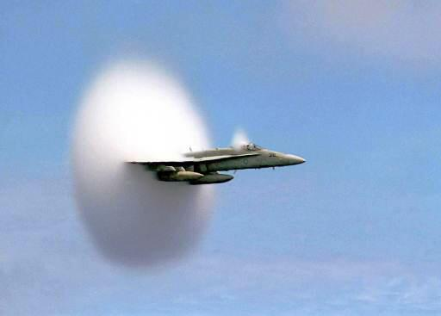
Mach 1 - breaking the sound barrier
Jet pilots flying at Mach 1 report noticeable wall or barrier which must be penetrated before achieving supersonic speeds
wall due to intense pressure front
flying within this pressure front produces very turbulent and bouncy ride
Right combination of conditions and events can occur to create an unbelievable event
F/A-18 Hornet passing through the sound barrier
→ exact instant it goes supersonic
Credit: US Navy photo by John Gay, public domain
water vapor, density and temperature just right
Navy Ensign John Gay made this phenomenal photograph on July 7, 1999 while aboard carrier USS Constallation as Navy Lt. Ron Candiloro flew by.
plane in transonic flight
normal shock waves emanating from behind the canopy and across wings and fuselage
condition will last for only an instant
once supersonic flow exists completely around the aircraft, sharp-angled sonic cones replace the normal shock waves

Slide 7
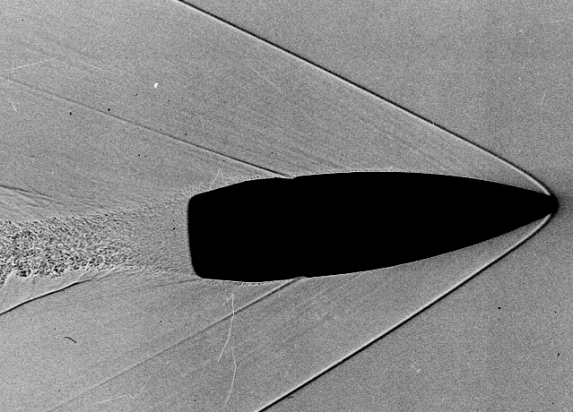
Source moving with v_{source}>c: Mach 1.4 - supersonic
sound source broken sound speed barrier
traveling at 1.4 times the speed of sound (Mach 1.4)
source moving faster than sound waves it creates→leads advancing wavefront
source will pass by observer before observer actually hears sound it creates
angle of Mach cone depends on ratio of source speed to sound speed
intense pressure front on Mach cone causes shock wave, sonic boom, as supersonic craft passes
shock wave advances at speed of sound c
it is built up from all of combined wave fronts
sound heard by an observer will be quite intense
supersonic aircraft usually produces 2 sonic booms
one from the aircraft's nose and other from its tail
resulting in a double thump
bullet travelling at Mach 2.45
Mach cone and shock wavefronts are very noticeable

Slide 8
Doppler Effect
Doppler shift
apparent change in acoustic frequency content of sound source due to motion of source relative to listener
as sound-source moves toward you, pitch is raised
as it moves away from you, pitch is lowered
Doppler effect
causes pitch of sound source to appear to rise or fall due to motion of source and/or listener relative to each other
enhance realism of simulated moving sound sources for compositional purposes
Doppler shift given by
ω_{s} - frequency emitted by source at rest
ω_{l} - frequency received by listener
υ_{ls} - listener speed relative to propagation medium in direction of source
υ_{sl} - source speed relative to propagation medium in direction of listener
c - sound speed
all quantities are scalars
But this is an approximation!

Slide 9
Moving source emits a sound at time τ, which is heard by a moving listener at time t.
v_{l}(t)
v_{s}(τ)
x_{s}(τ)
v_{sl}(τ)
V_{ls}(t)
x_{l}(t)
At time τ, source located at x_{s}(τ), moving at velocity v_{s}(τ), emits a sound
At time t, listener located at x_{l}(t), moving at velocity v_{l}(t), hears this sound

Slide 10
Vector Formulation
- 3D position
- time source emits sound
- time listener receives sound
- position of source at time τ
- position of listener at time t
- sound-source velocity
- velocity of listener
Consider Fourier component of source at frequency ω_{s}
Want shifted ω_{s}, ω_{l}, at listener
Doppler depends on velocity components along line connecting source & listener

Slide 11
Useful vector properties
Unit vector in the direction of
Scalar projection of onto vector is
Derivative of the magnitude of a vector
Dot product of velocity and unit length direction vector

Slide 12
Derivation of Doppler
At time t, listener hears sound produced at some previous time τ, so
Consider time derivative of this
Note τ depends on time t, since a small change in t must come from sound being produced at a different time τ.
has instantaneous phase φ=ω_{s}τ and instantaneous angular frequency . We need to find the new instantaneous angular frequency

Slide 13
Derivation of Doppler
Recall: derivative of magnitude of a vector
But
So
Rearranging terms, and writing time dependence,

Slide 14
Simplifications
Stationary listener:
Stationary source:
:
One dimensional:
<<

Slide 15
Backwards Sound
Source moves in straight line towards listener at constant speed 2c. For frequency f emitted by the source, what does the listener hear?
Treat listener as fixed at 0, and source at a negative position (x_{s}<0) with positive velocity. Doppler equation becomes
What does it mean to have negative frequency?
Suppose at time 0 source at position –d.
Sound emitted at time 0
Arrives at listener at time t =d/c.
2. Sound emitted at time T.
Source first travels at speed 2c for time T, then emits sound which travels rest of the distance, d=2cT+c(t-T)=cT+ct
Arrives at listener at time t= d/c-T.
→ Thus a sound emitted T later will arrive at the listener T earlier.
So listener hears the sound backwards

Slide 16
Vector Formulation Example
2D
Stationary listener
Source moves 5m/s
Closest distance is 5m
Projected source velocity at t=0
Perceived frequency ~ 1.013
Projected source velocity at t=1
Perceived frequency ~ 1.010
Projected source velocity at t=2
Perceived frequency ~ 1
Projected source velocity at t=3
Perceived frequency ~ 0.9898
Away from listener

Slide 17
Doppler Simulation
time-varying delay line results in frequency shift
Use for precise Doppler simulation
Consider Doppler shift from physical point of view
air analogous to magnetic tape which moves from source to listener at speed c
source analogous to write-head of tape recorder
listener corresponds to read-head.
When source and listener fixed
listener receives what source records
When either moves
Doppler shift observed by listener, according to

Slide 18
Doppler Simulation via Delay Lines
works for delay-line based computational model
magnetic tape is delay line
tape read-head is read-pointer of delay line
write-head is delay-line write-pointer
modulating delay by changing read-pointer increment from 1 to 1+v_{ls}
requires interpolated reads
corresponds to listener motion away from the source at speed υ_{ls}
changing write-pointer increment from 1 to 1+v_{sl}
use interpolating writes (de-interpolation) into delay memory
corresponds source motion toward listener at speed υ_{sl}

Slide 19
Time-Varying Delay-Line Reads I
If x(t) denotes input to time-varying delay,
output written as y(t)= x(t-D_{t})
D_{t} - time-varying delay in seconds
In discrete-time, D_{t} not integer multiple of sampling interval
y(t) approximated (in finite band) using bandlimited interpolation or other techniques for fractional delay
set x(t) to complex sinusoid at frequency ω_{s}:
output now
instantaneous phase of this signal is
differentiate for instantaneous frequency

Slide 20
Time-Varying Delay-Line Reads II
delay growth-rate equals relative frequency downshift:
Recall
time-varying delay simulates Doppler shift with
Assume moving listener only
Delay growth-rate set to speed of listener away from source, normalized by sound speed

Slide 21
Simple delay line
float *delayData; // circular delay buffer of audio samples
int delayBufLength; // Length of delay buffer in samples
int writePointer; // Write location in delay buffer
float readPointer; // Read location in delay buffer
// Set delay in number of samples, by finding read pointer relative to write pointer
void setDelay(float delayLength)
{
readPointer = writePointer - delayLength;
while(readPointer < 0) readPointer += delayBufLength;
}
//Process samples in channelData, put output in same buffer input came from
void process(float *channelData, int numSamples)
{
for (int i = 0; i < numSamples; ++i)
{
float in = channelData[i];
float out = delayData[readPointer];
// Store current sample in delay buffer
delayData[writePointer] = in;
// Increment pointers.
if (++writePointer >= delayBufLength) writePointer = 0;
if (++readPointer >= delayBufLength) readPointer = 0;
// Store output sample in buffer, replacing input
channelData[i] = out;
}
}

Slide 22
Variable Delay Line in Software
delayBufLength Buffer of size
delayLength variable delay line in C
Require delayLength <= delayBufLength.
use linear interpolation
out = delayData[readPointer];
replaced with
sampleBefore = floor(readPointer);
sampleAfter = (sampleBefore + 1);
Offset = readPointer - sampleBefore;
out = (1 - Offset) * delayData[sampleBefore] + Offset * delayData[sampleAfter];
Continuously varying delay
add delay growth parameter Δ to delayline function
++readPointer;//pointer update
changed to
readPointer+= 1-Δ;//pointer update
Δ=0, fixed delay line
Δ>0, delay grows g samples per sample
interpret as seconds per second, i.e.,
Need to simulate listener traveling toward source at speed

Slide 23
Code example
// Variables used in this example whose values are set externally:
float *delayData; // Our own circular delay buffer of audio samples
int delayBufLength; // Length of our delay buffer in samples
int writePointer; // Write location in the delay buffer
float readPointer; // Read location in the delay buffer
// User-adjustable effect parameters:
float delta_; // Derivative of delay time
//Set delay in fractional number samples by finding read pointer relative to write pointer
void setDelay(float delayLength)
{
readPointer = (float)writePointer - delayLength;
while(readPointer < 0) readPointer += (float)delayBufLength;
}

Slide 24
Code example
//Process group of samples in channelData, putting output in same buffer input came from
void process(float *channelData, int numSamples)
{
for (int i = 0; i < numSamples; ++i)
{
const float in = channelData[i];
float out = 0.0;
int sampleBefore = floor(readPointer);
int sampleAfter = (sampleBefore + 1) % delayBufLength;
float fractionalOffset = readPointer - (float)sampleBefore;
// Calculate output using linear interpolation between samples before and after
float out=(1 – fractionalOffset)*delayData[sampleBefore]
+ fractionalOffset *delayData[sampleAfter];
delayData[writePointer] = in; // Store current sample in delay buffer
//Increment pointers.Write pointer is integer so will wrap around strictly to 0
// read pointer is fractional so may wrap around to a fractional value
if(++writePointer >= delayBufLength) writePointer = 0;
readPointer += 1.0 - delta_;
if(readPointer >= delayBufLength) readPointer -= (float)delayBufLength;
// Store the output sample in the buffer, replacing the input
channelData[i] = out;
}
}

Slide 25
Variable Delay Line in Software
Model of physical propagation-path geometry
→ read- and write-pointers separated by predictable minimum & maximum delay intervals
unnecessary to worry about read-pointers passing write-pointers
unnecessary to worry about write-pointers passing read-pointers
Other cases
Generic frequency shifters
Time and pitch scale modification
Doppler simulator not driven by changing geometry
→read- and write-pointers may get too close to each other
read pointer will eventually ``catch up to'' or ``fall back into'' write pointer location
discontinuity issues caused when read and write pointers cross
pointer cross-fade scheme may be necessary

Slide 26
Multiple Read Pointers
Used to simulate multiple listeners
Each read-pointer signal can be filtered to simulate
propagation losses
radiation characteristics
of source in direction of listener
Read-pointers can move independently to simulate different Doppler shifts associated with
different listener motions
relative source directions

Slide 27
Multiple Write Pointers
If write pointers at fixed spacing
equivalent to multiple read pointers
provide basic multipath simulation
If write pointers moving independently
induce independent Doppler shifts due to source motion
each write-pointer represent signal from separate source to single listener
each write-signal can be passed through its own filter
implement all filtering on propagation path from source to listener
all write pointers have same input signal
their filters can be implemented using series chain
outputs of successive filters correspond to progressively longer propagation paths
progressively more filtering
reduce filter order required for propagation paths longer than shortest
all but first write-pointer simply sum into shared delay line
write-pointers may cross each other with no ill effects

Slide 28
Multiple Write Pointers
single delay line simulates many moving listeners or many moving sources
many moving listeners and many moving sources
different listeners do not see same Doppler shift for each moving source
listener's read-pointer motion can be adjusted to correct for Doppler shift seen from any particular source
cannot correct for more than 1 in general
→ Not possible to share a single delay line
need as many delay lines as there are sources or listeners, whichever is smaller
N moving sources, M moving listeners → min(N,M) delay lines

Slide 29
Delay line with multiple read and write pointers, corresponding to multiple sources and listeners.
Source1
Source2
Source3
Write pointers
Delay line
Read pointers
Listener1
Listener 2

Slide 30
Stereo Processing
Stereo processing of many sources accomplished using 2 delay lines
corresponding to left and right stereo channels
stereo mix may contain panned mixture of many sources, each with
stereo placement
path filtering
Doppler shift
2 stereo outputs may correspond to
``left and right ears,'' or
left- & right-channel microphones in studio recording set-up

Slide 31
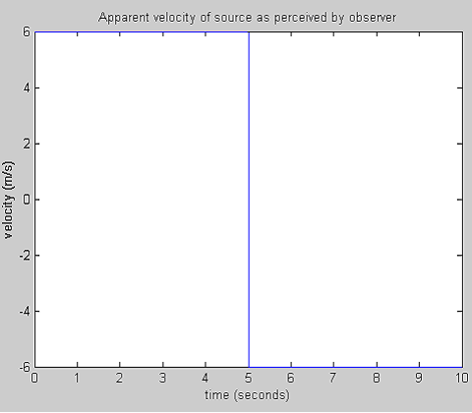
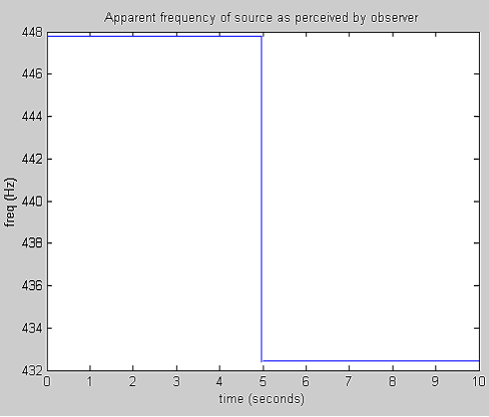

Sound Example I
stationary observer & moving sound source
or stationary source & moving observer
source moving on straight line passing through observer
Initial distance from source to observer s=30 m
velocity of source v=6 m/s

Slide 32
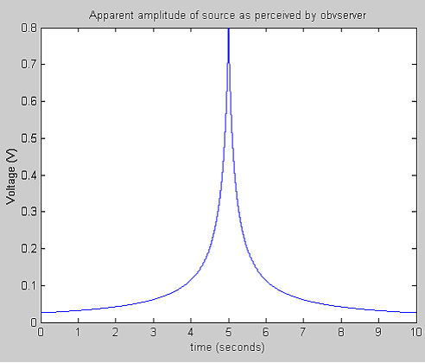
Sound Example I

Slide 33
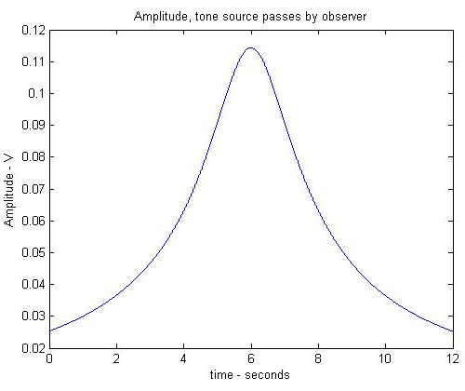
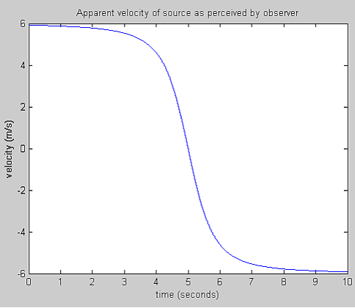
Sound Example II
stationary observer & moving sound source
source moves on straight line some minimum distance from observer
Initial distance from source to observer s=30 m
Velocity of source v=6 m/s
Minimum distance d=5m

Slide 34
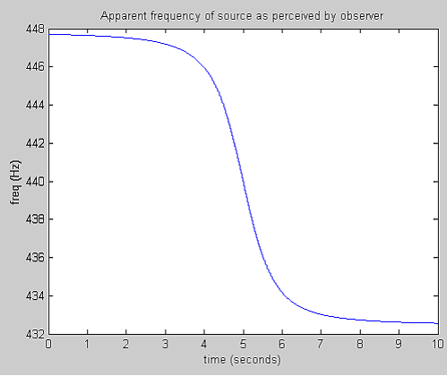
Sound Example II

Slide 35
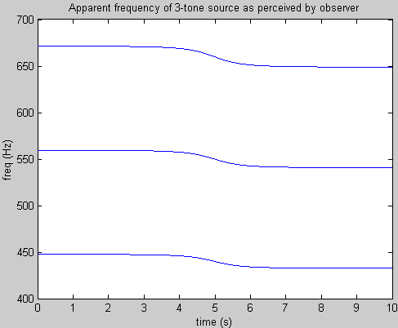
Sound Example III
3 tone signal
stationary observer
moving sound source
source moves on line some minimum distance from observer
Initial distance from source to observer s=30 m
Velocity of source v=6 m/s
Minimum distance d=5m

Slide 36
Leslie speaker
Moving
loudspeaker
horn
Stationary
listener
Moving loudspeaker and stationary listener,

